Slide 1
Integrating physics-based depletion into fuel cycle simulation: When, how, and why
Steven E. Skutnik
University of Tennessee-Knoxville
2nd Technical Workshop on Fuel Cycle Simulation Columbia, SC

Slide 2
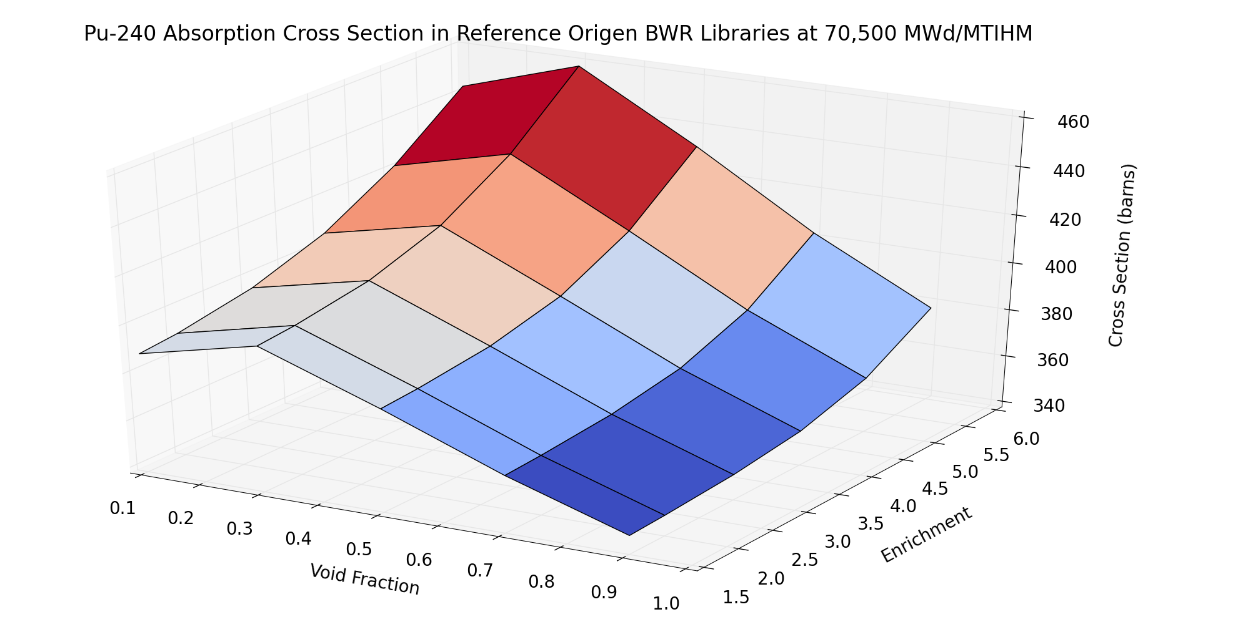
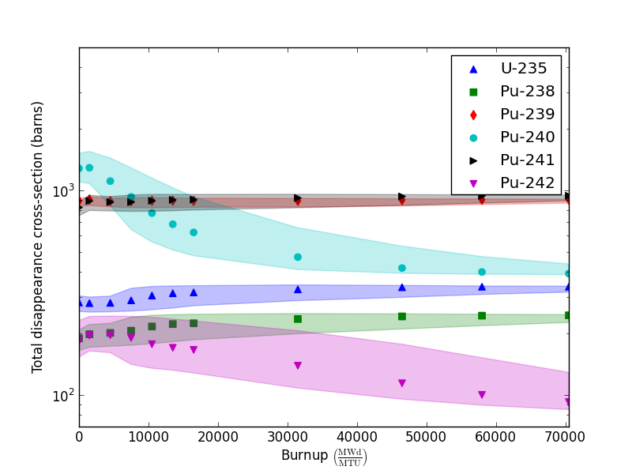
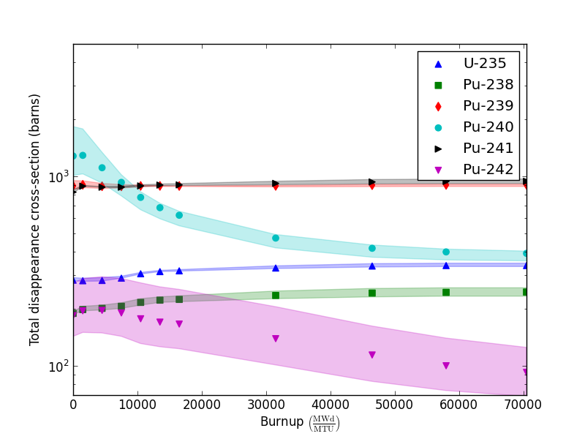
Thermal-spectrum one-group cross-sections are highly sensitive to burnup & initial compositions
Initial enrichment
Average void fraction

Slide 3
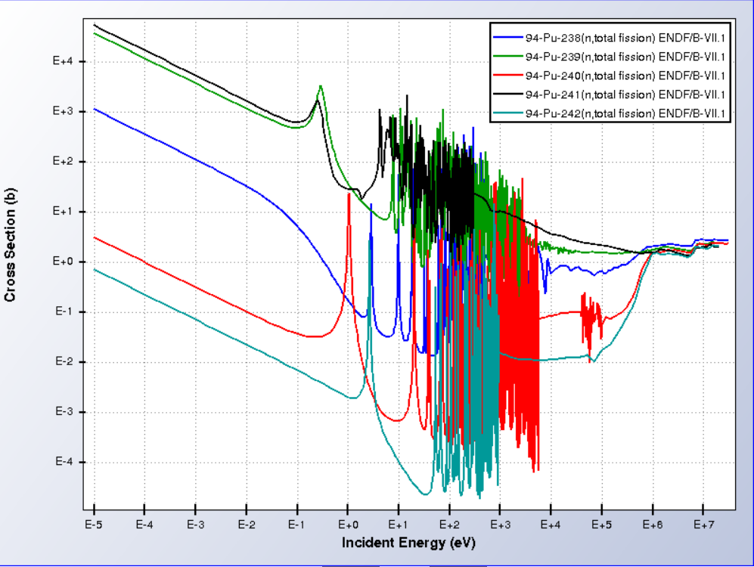
Reaction cross-sections show much higher sensitivity to perturbations in thermal energy region vs. fast

Slide 4
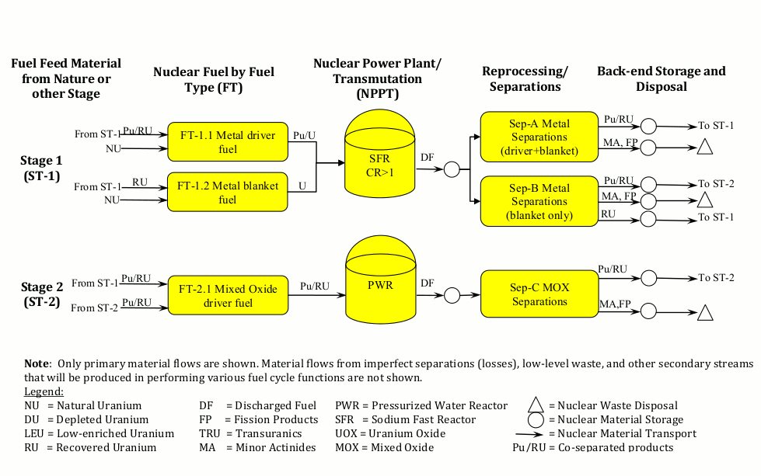
Example: EG29 scenario
Thermal spectrum: high CX sensitivity: CXs highly sensitive to (dynamic) initial Pu composition & burnup; physics necessary
Fast spectrum: low CX sensitivity: Physics desirable, not “necessary”

Slide 5
A tale of two MOXes
MOX 17x17 (PWR)
8% Pu / NU 33 GWd/MTHM
1 MTHM basis
61.1 kgPu / iMT MOX
24.5
GWd/MTU
Depletion
W17x17 (PWR) 4.0 % enrichment
59.9 kgPu / iMT MOX
49.0
GWd/MTU

Slide 6
Development and function of an Origen-based Reactor Analysis module (CyBORG)

Slide 7

Introducing CyBORG: Cyclus-Based ORIGEN
Assimilating physics-based depletion into fuel cycle scenario development

Slide 8
How do we incorporate ORIGEN into Cyclus?
Newest ORIGEN API facilitates direct, in-memory calls to ORIGEN solver
By developing a portable, embeddable “depletion engine,” ORIGEN operations can be “wrapped” into a Cyclus-friendly format
“Depletion engine” builds from ORIGEN API (from shared SCALE/Origen libraries)
Notes:
i.e., the “secret sauce” to developing an ORIGEN-based NFIM will be in the development of the standalone “depletion engine,” a portable set of “builder’s libraries” that encapsulate all of ORIGEN’s functions in a way that can be easily wrapped into Cyclus-facing calls
-To be portable, this will take the form of an embeddable library containing ORIGEN solver functionality OUTSIDE of SCALE – i.e., capturing all of the functionality inside a single, portable library
Note that this supports MORE than just depletion operations; provides for a general resource for physics-based operations (source terms: heat & activity, etc.); supports both general physics & other modules

Slide 9
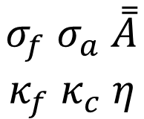
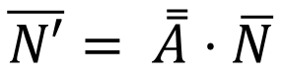
CyBORG provides physics-based flexibility for reactor simulations within Cyclus via coupling with Origen
Input fuel recipe
CyBORG
Output fuel recipe
Fuel cycle data
Initial compositions
Output compositions
Powers
$$σ_{f} σ_{a} \overset{̿}{A}$$
$$κ_{f} κ_{c} η$$
C++ primitives only!
(no proprietary types)
Cycle burnup(s)
Cyclus/Origen interface layer
Origen reactor data libraries
Assembly type
Interpolable params
Problem-specific reactor data
Origen 6.2 API
$$\overline{N′}= \overset{̿}{A}⋅\overline{N}$$
Notes:
Note that the Cyclus / Origen interface layer exposes only C++ primitives and standard library types, thereby effectively insulating Cyclus from Origen-specific types and vice versa.

Slide 10
CyBORG balances the performance cost of depletion via a “hash-and-cache” recipe generation strategy†
Because of the relative cost of depletion (and reactor data library interpolation) relative to simulation time, we only to invoke physics-based depletion when necessary
Solution: Cache output recipe (generated via depletion) to a unique hash based on relevant depletion conditions
e.g., initial enrichment, fuel type, discharge burnup
†Special thanks to Paul Wilson from UW-Madison for this idea

Slide 11
Generalized reactor data interpolation and processing within CyBORG

Slide 12
Accurate depletion calculations require problem-dependent nuclear data
Problem-specific nuclear data is required to dynamically produce accurate output inventories
Flux spectrum evolves with initial enrichment, void, burnup, etc.
Origen handles this through interpolating pre-generated libraries to problem-specific conditions (e.g., initial enrichment, burnup, etc.)
Libraries developed transport calculations
“Assembly average” cross-sections

Slide 13
Example dimensions for N-D interpolation
Initial composition
Each parameter is treated as orthogonal, creating an N-dimensional interpolation (hyper-)space
²³⁵U
²³⁹Pu : Pu
²⁴¹Am
Interpolation dimensions are unspecified until problem time (i.e., space is created dynamically)
Void fraction
Temp. / power level
Burnup
N-D space collapsed to 1-D and then interpolated along burnup dimension for problem-specific burnups

Slide 14
N-dimensional interpolation approach
Determine adjacent 1-D “knots” for each dimension
Determine independent weight factors for each dimension
Apply appropriate weights to cross-section data across each dimension
(u´,v´)
Notes:
CHALLENGE here is to provide a GENERALIZED approach to interpolation across many dimensions which are unknown until run-time
C_i and C_j based on u’ and v’ only; idea is to calculate the relative “weights” in each independent dimension and then apply an independent interpolation across each dimension. Trying to touch “minimum” amount of data possible (for speed)
Amenable both to linear, lagrangian polynomial, and cubic spline type interpolation
Initial testing shows this appears to scale up to ORIGEN-sized datasets & anticipated interp dimensions reasonably well

Slide 15
Conclusions

Slide 16
Current status of CyBORG
CyBORG is designed to work with the latest SCALE 6.2.2 release
CyBORG v1.0 is now available for download and is fully compatible with Cyclus v1.5
CyBORG repository: https://github.com/sskutnik/cyborg

Slide 17
Acknowledgements
This work has been funded by a Nuclear Energy University Programs (NEUP) grant sponsored by the U.S. Department of Energy, Office of Nuclear Energy, award number DE-NE0000737

Slide 18
Questions?
sskutnik@utk.edu
https://github.com/sskutnik/cyborg

